Slide 1
CPE413 Kablosuz Ağlar
Bilgisayar Mühendisliği Bölümü, Mühendislik Fakültesi
Dr. Sait DEMİR
saitdemir@karabuk.edu.tr
19.10.2021

Slide 2
Transmission Fundamentals
Notes:
This is a general introduction and basically not networking, topics usually covered and studied by electrical and electronic engineering
Bu genel bir giriştir ve temelde ağ oluşturma değildir, genellikle elektrik ve elektronik mühendisliği tarafından ele alınan ve incelenen konulardır.
But we need to know a bit about these fundamental
Ama bu temeller hakkında biraz bilgi sahibi olmamız gerekiyor.

Slide 3

Methods of Wireless Communication
Fundamentals of Wireless Communication
signal
Modulation
Frequency
Radio frequency
Receiver - Transmitter
Antenna, Distance-Propagation

Slide 4
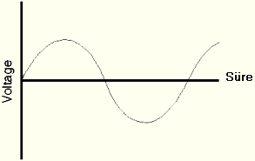
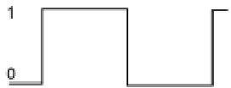
Methods of Wireless Communication
Signal; (Sound signal) is any sound converted into electromagnetic energy to be transmitted or stored. (It is the electrical form of sound.)
- Analog (on continuous scale)
- Digital (limited scale)

Slide 5
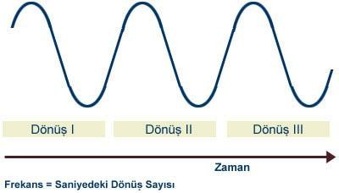
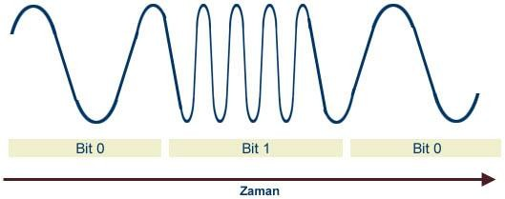
Analog Sinyal
Basic components of an analog signal amplitude, phase angle and frequency.
The wavelength of the analog signal is called amplitude.
Each repeating wave in this curve is called a cycle.
The number of rotations per second is called frequency and is referred to as Hertz in communication terminology.
When data is transported over a line, it is sent using frequencies.
The wavelength of the analog signal is assumed to be known or fixed.
Bandwidth refers to frequency ranges.

Slide 6
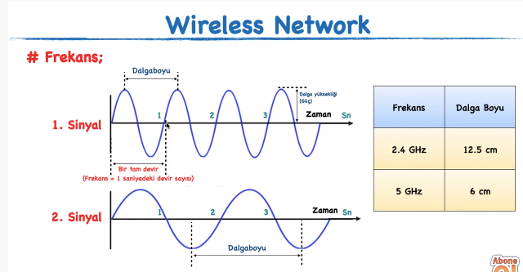

Slide 7
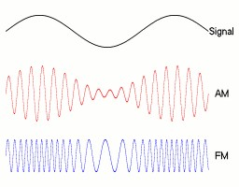
Modulation
Modulation; Low-frequency information signals are superimposed on high-frequency carrier signals and The process of sending data over long distances is called Modulation. (It is combining a carrier signal with an information signal)
(Continuous wave modulation; methods with a sine signal as the RF carrier)
- Amplitude Modulation (AM-Amplitude Modulation)
Phase Modulation(PM)
Frequency Modulation(FM)
The modulating information signal waveform is shown in the first figure.
In the second figure, the amplitude modulated signal is
In the third figure, the waveform of the frequency modulated signal is shown.

Slide 8
Modulation
Low frequency signals are not directly emitted as electromagnetic waves.
Two signals are needed to perform the modulation process: INFORMATION SIGNAL and CARRIER SIGNAL.
Low frequency information signal, It is also called modulation signal, signal to be sent, low frequency (AF) signal.
High frequency carrier signal can also be called modulated RF (Radio Frequency) signal or porter signal.
In the modulation process, the modulating signal is the information signal that is being modulated or
The modulated signal is the carrier signal.

Slide 9
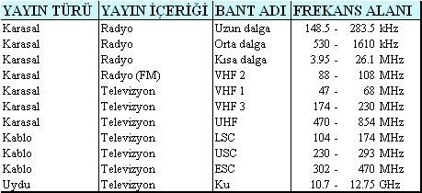
Frequency
Frequency ; (vibration number) is the measurement of how often and how many times an event is repeated within a unit of time (typically 1 second).
Radio Frequency; means the carrier signal modulated by an information signal.
It is also used in the sense of High Frequency.

Slide 10
Propagation Characteristics of Radio Waves
Frequency range | Frequency Band | Propagation Characteristics
Low | 300 KHz | Because they are broken by the curvature of the earth, they spread closely.
High | 1 MHz | They do not spread close to the ground.
Short-wave | 3 – 30 MHz | They are reflected back to the earth from the ionosphere and can travel long distances.
very high | 100 MHz | Can spread in the visible area, can also cross the horizon
extremely high | 1 GHz | It can spread in the visible area and extend beyond the horizon. can pass

Slide 11
Decibel
Decibel; The intensity of sound is measured in decibels (dB). It is a logarithmic and dimensionless unit generally used for sound intensity, indicating the ratio to a specific reference power or quantity level.
The frequencies perceived by the human ear are between 20 Hz and 20 kHz
(20 000 Hz).
Sound Level (dB) Known Sounds
0 dB The lowest sound the human ear can hear 30 dB Whisper quiet speech
50 dB Rainfall quiet office Refrigerator Ventilation 60 dB Dishwasher Sewing machine normal conversation. 70 dB Heavy traffic vacuum cleaner hair dryer 80 dB Alarm clock Metro ;factory noise
90 dB Shaving machine Truck traffic Lawn mower 100 dB Snowmobile garbage truck stereo
110 dB Rock concertelectric Saw 120 dB Airplane airport night club 130 dB Drill hammer
140 dB Shotgun Air attack warning system 180 dB Rocket launcher

Slide 12
Wireless Communication Environments
Radio Waves; With radio vibration count These are electromagnetic waves occurring. (long wavelength)
Microwave; The wavelength of the electromagnetic wave is 1
It defines the frequencies where it is shorter than one meter. (Terrestrial, Earth) [Satellite] The most important principle difference between radio and microwave; Lots of radio broadcasts directional, whereas microwaves are unidirectional.
İnfrared; (Infrared, Infrared, IR) radiation, visible wavelength longer than light but shorter than terahertz radiation and microwaves
is electromagnetic radiation.
Lazer; (Light Amplification by Stimulated Emission of Radiation) optical source that creates photons in the form of a coherent beam. The basis of the laser is based on photons of light created by electron transitions between atomic or molecular energy levels.

Slide 13
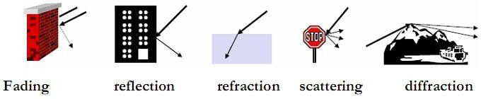
Signal Propagation
The strength of the signal and its path are affected by some factors.
Fading, shadowing, reflection, refraction, scattering, diffraction at edges

Slide 14
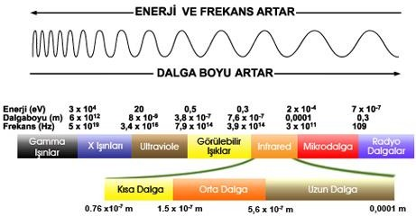
Electromagnetic Spectrum
All electromagnetic radiation and different types of radiation made possible by the laws of physics anywhere in the universe. expressing the relative places of radiation derivatives in this spectrum according to their wavelengths or frequencies is the concept.
any object
electromagnetic spectrum or spectrum,
characteristic net electromagnetic force emitted by that object to its surroundings
refers to radiation.

Slide 15
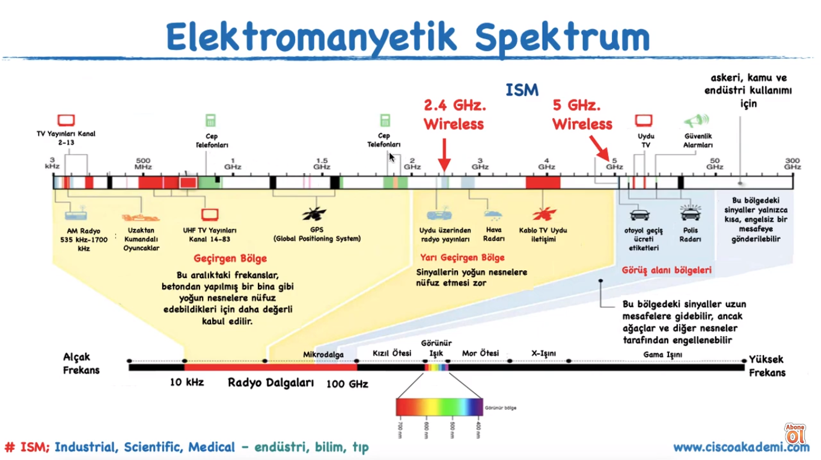

Slide 16
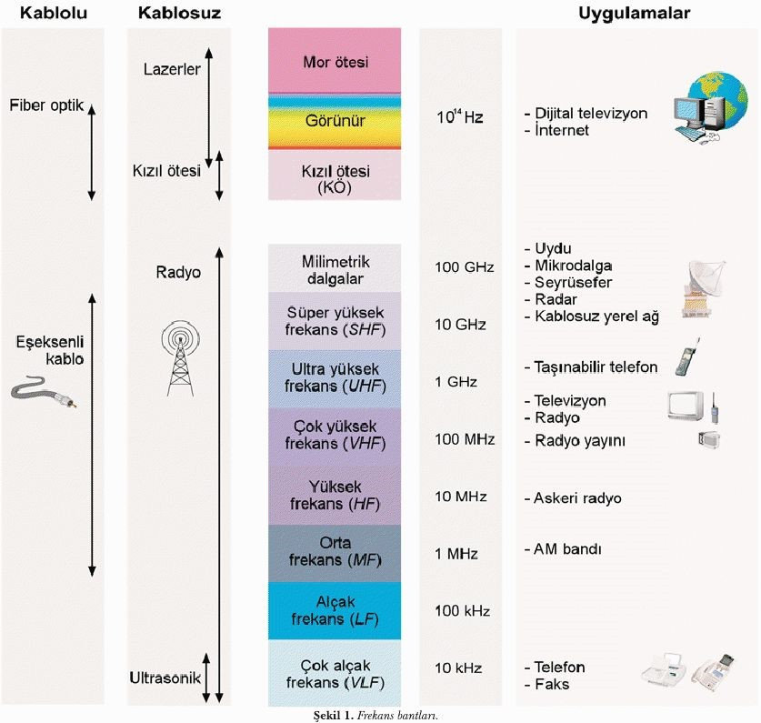

Slide 17
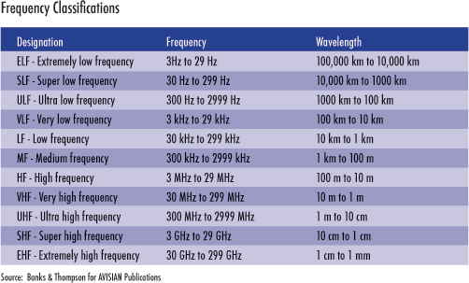
RF Spectrum

Slide 18
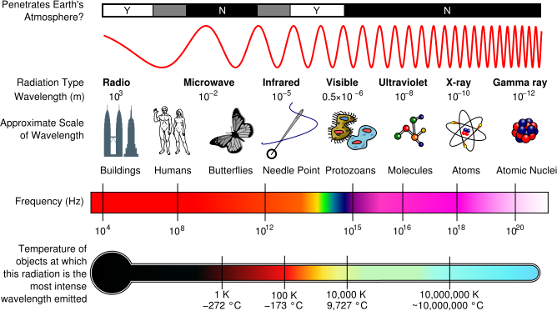

Slide 19
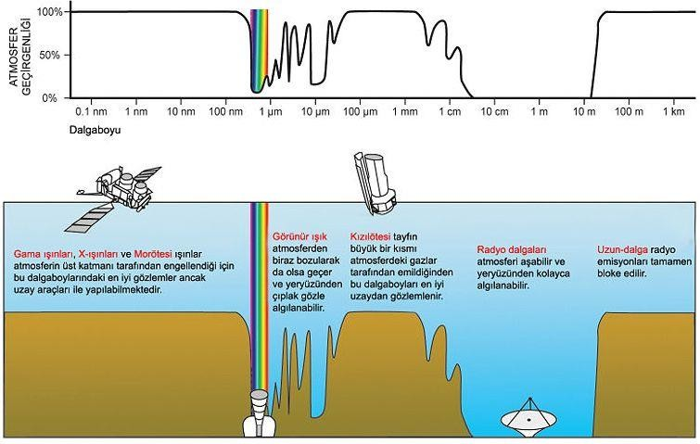

Slide 20
Electromagnetic Signal
Function of time
Can also be expressed as a function of frequency
Frequency is the measurement of how often and how many times an event is repeated within a unit of time (generally 1 second). The unit of frequency is Hertz.
Signal consists of components of different frequencies
Notes:
Electromagnetic waves or EM waves are waves that are created as a result of vibrations between an electric field and a magnetic field. In other words, EM waves are composed of oscillating magnetic and electric fields.
Elektromanyetik dalgalar veya EM dalgalar, bir elektrik alanı ile bir manyetik alan arasındaki titreşimlerin bir sonucu olarak oluşturulan dalgalardır. Başka bir deyişle, EM dalgaları salınan manyetik ve elektrik alanlarından oluşur.
Electromagnetic signal is used as a means to transmit information
Elektromanyetik sinyal, bilgi iletmek için bir araç olarak kullanılır
This wave or signal does not need a physical medium to transmit from A to B
Bu dalga veya sinyalin A'dan B'ye iletilmesi için fiziksel bir ortama ihtiyacı yoktur.

Slide 21
Ders konuları
signals
Display of signals in time domain
Display of signals in frequency plane
Analog and digital data transmission
Channel capacity
Nyquist Channel capacity
Shannon Channel capacity
Transmission media
terrestrial microwave
satellite microwave
broadcast radio
Infrared
2

Slide 22
signals
Electromagnetic signals are signals used in wireless communication and allowing data to be transmitted from one place to another..
An electromagnetic signal expressed as a function of time can be done.
However, its representation in the frequency plane is widely used, especially in the analysis of complex signals.
3

Slide 23
Display of signals in time domain
An electromagnetic signal can be represented analog or digital as a function of time.
In an analog signal, the change with time is slow and can take infinite values ​​in the range.
However, in a digital signal, the change over time is sudden and one of a certain number of values.
The number of values ​​that can be taken in a digital signal is certain and not infinite as in the analog signal.
As a function, we can express the analog signal as differentiable continuous functions and the digital signal as non-differentiable discontinuous functions.
5

Slide 24
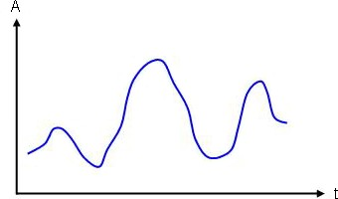
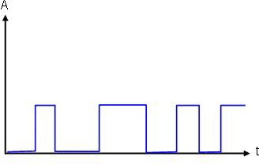
Display of signals in time domain
Below are examples of analog signals and digital signals
Analog sinyal
Discrete sinyal
In the figures, A (Amplitude) indicates amplitude and t indicates time.
6

Slide 25
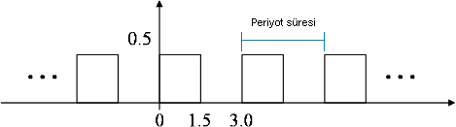
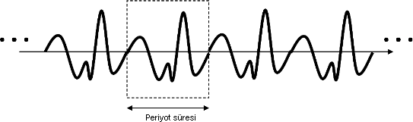
Display of signals in time domain
Analog or digital signals are divided into two basic groups: periodic and aperiodic..
Periodic signals repeat a certain part of it indefinitely.
Aperiodic signals, on the other hand, do not contain infinitely repeating parts.
The figure shows examples of analog and digital periodic signals.
Periyodik analog sinyal
Periodic digital signal
7

Slide 26
Display of signals in time domain
Mathematically, a periodic signal can be expressed as follows.
Here, T indicates the period duration of the periodic signal and its unit is seconds. Time T is the time it takes for the smallest repeating segment to complete a cycle.
A sine wave is the most basic analog signal and is expressed by three parameters. These; They are called amplitude (A), frequency (f) and phase (phase - φ) .
Peak amplitude is the highest amplitude value of the signal over time and is usually measured in volts.
8

Slide 27
Display of signals in time domain
The number of repetitions of a periodic signal per second is called frequency. Its unit is expressed as Hz (Hertz).
Period is the completion time of a cycle in seconds and its unit is seconds. The period is usually denoted by T in the literature.
The period value is inversely proportional to the frequency and
Phase refers to the angle at which a period begins and is expressed in degrees or radians.
Using these parameters, a sine wave can be expressed as follows;
Here, A is peak amplitude, f is frequency and φ is the phase angle
9

Slide 28
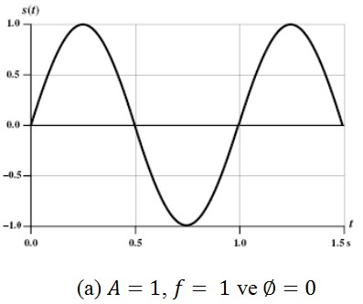
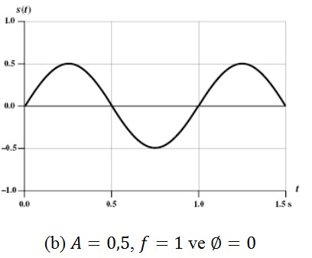
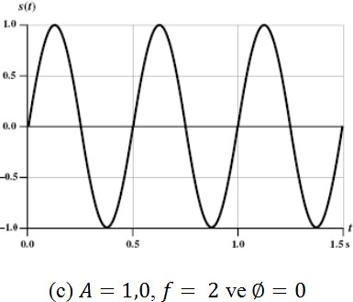
Sinyallerin zaman düzleminde gösterimi
Three different periodic sine signals are given as examples in the figure
10

Slide 29
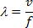
Sinyallerin zaman düzleminde gösterimi
The wavelength of a signal is expressed as the path covered by one period of the periodic signal in space and its unit is meters..
It is indicated by wavelength. The wavelength is expressed by the following equation
.
Here, v is the distance traveled by the signal per second and its unit is meter/sec.The speed of the signal is taken as equal to the speed of light in vacuum and is taken as 3.10⁸ m/s. T is the period time and its unit is meter.
Wavelength is expressed in meters. Based on the above equation, we can express the wavelength of a signal with frequency as follows:.
11

Slide 30
Sinyallerin zaman düzleminde gösterimi
as the frequency of a signal increases, its wavelength decreases.
This expression is very important especially in terms of antenna design in wireless communication.
It is important.
The wavelength of the signal that the antenna best receives or sends is directly proportional to the length of the antenna.
As the wavelength of the signal shortens, in other words, as its frequency increases, the physical size of the antenna to be used decreases and the cost decreases.
12

Slide 31
Display of signals in frequency plane
Generally, an electromagnetic signal is expressed as more than one sine signal, and such signals are called complex signals
The signal expressed by the equation below is a complex signal formed by the combination of two sine signals
The first component in the complex signal has an amplitude of 4 and a frequency of 1f Hz. The second component has an amplitude of 2 and a frequency of 2f Hz
14

Slide 32
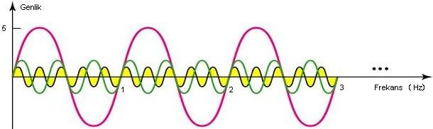
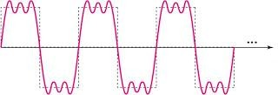
Sinyallerin frekans düzleminde gösterimi
The complex signal obtained by combining three sinusoidal signals is given below
15

Slide 33
Analog and digital data transmission
Analog and digital expressions determine the way the signals change and the number of values ​​they can take.
Data carries or contains information.
Signals are used to represent data.
Transmission refers to the transmission of data between two points using signals.
Analog data takes continuous values ​​and value changes are slow.
digital data, on the other hand, changes value with sudden changes and the number of values ​​they can take is limited.
The audio signal is analog and has constantly changing data.
Binary data is numerical data and has instantaneous changes. Moreover,The number of values ​​they can take is two.
17

Slide 34
Analog ve sayısal veri iletimi
Signals are used to transport data in communication systems.
Analog signal is an electromagnetic signal that constantly changes value.
The frequency of the analog signal is important in determining the medium to be used for transmission.
For example, as the frequency decreases, twisted pair cables or coaxial are used, as the frequency increases, atmosphere or space is used.
A digital signal is a signal that changes amplitude between a certain number of values, usually transmitted over copper wire.
It is very easy to encode and retrieve data with digital signals. They are also less affected by noise than analog signals
The biggest disadvantage of digital signals is their use in transmission environments. Because they encounter greater resistance than the analog signal amplitude losses are greater.
18

Slide 35
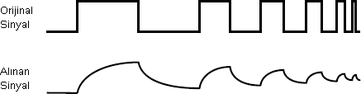
Analog ve sayısal veri iletimi
A digital signal can be seen as it originates from its source and as it is received by the receiver.
High-frequency digital signals have higher distortion rates caused by the environment than low-frequency signals.
In high-frequency digital signals, it is not possible to receive data above the signal at the receiving end.
Therefore, especially in wireless environments, high frequency analog signals are used in data communication
19

Slide 36
Analog ve sayısal veri iletimi
Both analog and digital data can be transmitted by representing them with both types of signals.
If the data to be sent is analog, some operations are performed to express it on the signal to be used.
The digital data to be sent is expressed on the signal by performing some operations in another way.
We can transmit both analog and digital data using analog or digital signals.
20

Slide 37
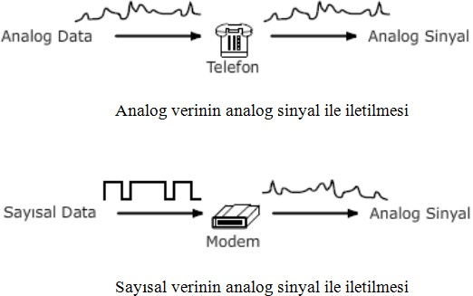
Analog ve sayısal veri iletimi
Transmission of analog and digital data via analog signal
21

Slide 38
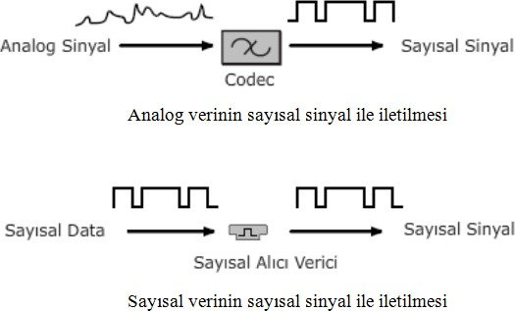
Analog ve sayısal veri iletimi
Transmission of analog and digital data via digital signal
22

Slide 39
Analog ve sayısal veri iletimi
Analog data generally has low bandwidth and can be represented by an electromagnetic signal on its own band.
For example, sound waves are in the band 20 Hz to 20 kHz. Your
Most of the energy is spent between approximately 100 Hz and 7 kHz.
Standard audio signals used in telephone communications range from 300 Hz to 3400 Hz.
Telephone devices create and transmit an electromagnetic signal with the same frequency as the audio signal.
Today, carrying analog data with a higher frequency carrier signal outside the band it is in is widely used in communication via radio and television.
In the transmission of analog data with an analog signal, the signal is usually Amplifiers are used to increase the amplitude.
23

Slide 40
Analog ve sayısal veri iletimi
Digital data can be transmitted via analog signal. modem for this
(MOdulator DEModulator) devices are needed.
Modems convert the digital data on the sending side into an analog signal and recover the original digital data from the analog signal on the receiving side.
This is how dial-up and xDSL modems used in today's residences work.
Analog data can be transmitted using digital signals. For this, it is necessary to first make measurements on the analog data at periodic intervals and produce numerical values ​​according to the obtained values.
Today, devices called codec (COder DECoder) are used for this process.
Analog data is obtained again from the digital signals received at the receiver side.
24

Slide 41
Analog ve sayısal veri iletimi
Digital data can be transmitted using a digital signal. The amplitude of the digital signal is changed according to the binary value of the digital data and sent to the transmission medium.
Today, devices such as Ethernet cards, repeaters and switches perform this process.
On the receiving side, digital data is obtained again according to the level of the received digital signals.
25

Slide 42
Channel capacity
Many factors in the transmission medium cause changes in the signal.
If these changes exceed a certain level, the data sent on the signal cannot be correctly detected at the receiver.
The most important of these distortions is the combination of some unwanted signals in the environment with the sent signal and the shape of the sent signal.
As a result, as the noise level increases, it significantly affects the signal quality and therefore the quality of communication.
The maximum data rate that can be transmitted under given conditions in any transmission environment is called channel capacity.
27

Slide 43
Kanal kapasitesi
The terms data rate, bandwidth, noise and error rate are related to capacity.
Data rate is the amount of bits transmitted per second under given conditions in the transmission medium and is expressed in bps (bit per second).
Bandwidth expresses the difference between the minimum and maximum frequency components of the signal sent in the transmission medium and is shown in Hz.
Noise refers to the average noise level in the transmission medium.
Error rate refers to the rate at which an error occurs. An error in data communication is when a sent bit is perceived by the receiver as 0 when it is 1 or as 1 when it is 0.
28

Slide 44
Nyquist kanal kapasitesi
Capacity for a theoretical noise-free channel by Nyquist has been revealed.
The channel capacity recommended by Nyquist is expressed as follows.
Here, M represents the number of levels in the digital signal.
As the number of levels in the signal increases, the channel capacity for a noise-free channel will increase.
However, as the difference between levels decreases in noisy channels
The rate at which noise distorts the signal increases, thus increasing the error rate.
30

Slide 45
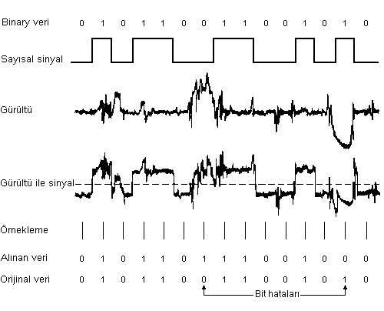
Shannon kanal kapasitesi
Double the bandwidth according to the channel capacity recommended by Nyquist.
When we double it, the channel capacity also doubles.
However, in real noisy environments, there is no such relationship between channel capacity and bandwidth.
Noise in the transmission medium that persists for a certain period of time causes deterioration.
If we increase the bit rate,
more bits will be affected in
the same period of time.
32

Slide 46
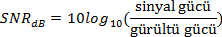
Shannon kanal kapasitesi
Channel capacity, which takes into account the amount of noise in the transmission medium, was expressed by Claude Shannon as follows:
Here, B indicates the bandwidth and its unit is Hz. SNR shows the ratio of signal to noise in the transmission medium. The ratio of signal to noise can be found with the following equation:
.
As the ratio of signal strength to noise strength decreases, the quality of communication decreases and signal distortions increase.
33

Slide 47
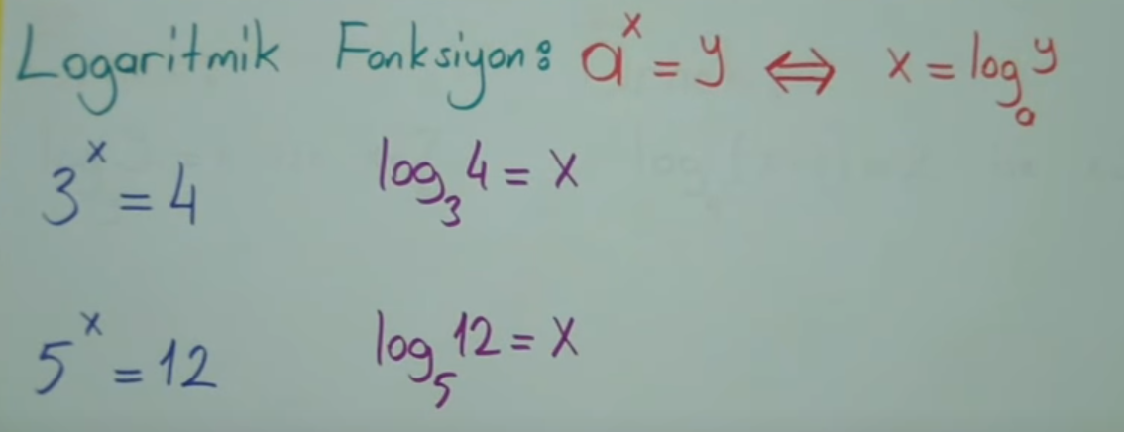
Shannon kanal kapasitesi
Örnek
The channel in a transmission medium is between 10 MHz and 20 MHz. SNRdb is given as 20 dB. What is the maximum channel capacity and number of signal levels to use?
Shannon channel capacity:
Number of levels in the signal:
34

Slide 48
Transmission media
The transmission medium is the physical path between the sender and the receiver. Transmission media are generally divided into two groups: guided and unguided.
Guided media include twisted pair cables, coaxial cables and fiber optic cables. In these environments, the path that the signal will follow depends on the path followed by the transmission medium and is determined.
Unguided transmission media are atmosphere and space. This transmission. In environments where the signal originating from its source disperses and spreads in the environment, only a part of it reaches the receiver.
Depending on the frequency of the signal and atmospheric conditions, the components of the signal can reach the receiver in different times and following different paths.
36

Slide 49
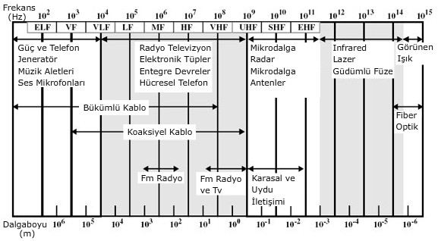
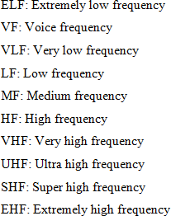
İletim ortamları
The transmission medium is the physical path between the sender and the receiver.
In wireless environments, low-frequency signals generally propagate omnidirectionally, while high-frequency signals propagate directionally.
37

Slide 50
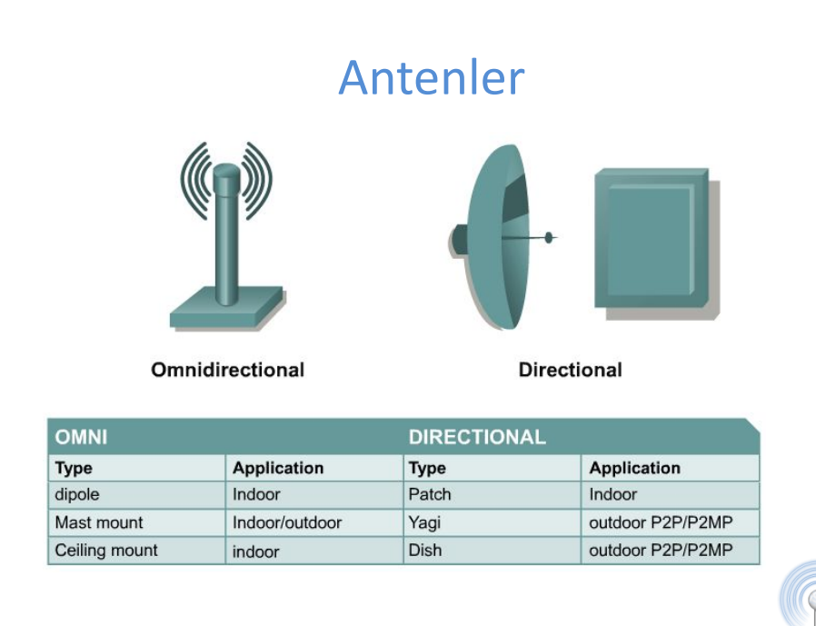

Slide 51
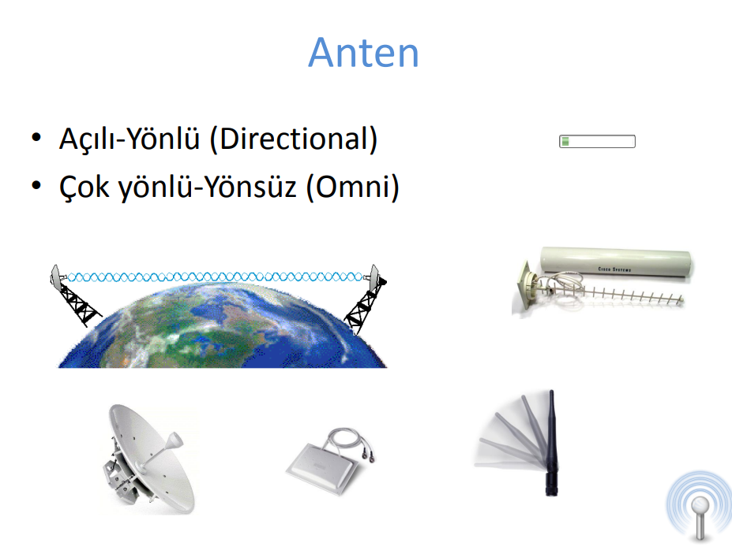

Slide 52
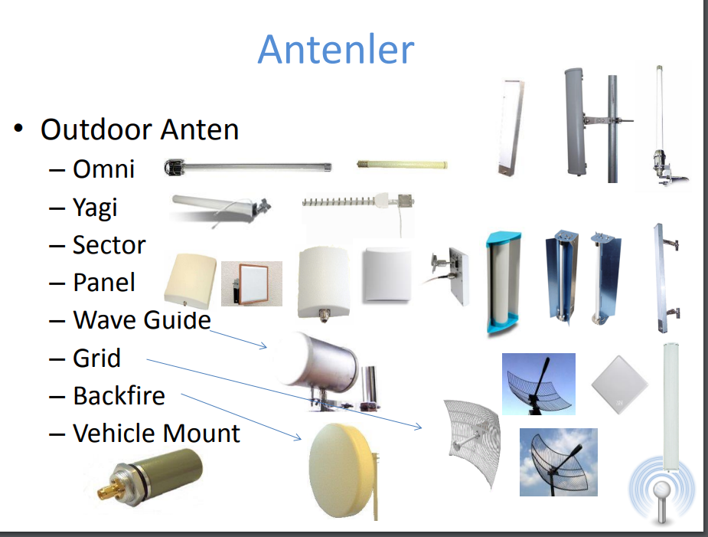

Slide 53
İletim ortamları
For sending and receiving in unguided transmission environments it is necessary to use an antenna.
The sending antenna radiates electromagnetic signals into the transmission medium, and the receiving antenna collects the electromagnetic signals in the medium.
Three different frequency bands play an important role in wireless communication. These; 1 GHz is the band between 30 MHz and 1 GHz, and the bands between 3x10^11 Hz and 2x10^14 Hz.
Signals at and around 1 GHz, called microwave frequencies, show high focus and propagate in the line of sight (LOS).
They are especially widely used in point-to-point communications.
Microwaves are used in satellite communications.
38

Slide 54
İletim ortamları
The band between 30 MHz and 1 GHz, called radio waves, has omnidirectional propagation and is used in audio and video broadcasting and special purpose applications.
Another important band, the frequencies between 3x10^11 Hz and 2x10^14 Hz, is called infrared and is widely used in short-distance point-to-point applications.
39

Slide 55
terrestrial microwave
The most commonly used microwave antenna is the parabolic dish antenna.
The most commonly used size is 3m in diameter.
In terrestrial microwave communication, antennas are well focused on each other and perform LOS communication.
Microwave antennas are usually placed at very high points so that they can overcome obstacles and reach a wider area.
Since microwave communication is a cost-effective solution over long distances, it is used instead of coaxial or fiber optic.
Audio and video communication are the primary application areas. The two most important application areas are cellular systems and fixed wireless access applications.
41

Slide 56
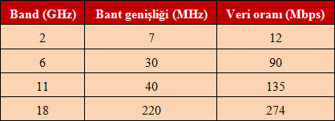
terrestrial microwave
Microwave communications cover most of the spectrum.
Band between 2 GHz and 40 GHz in microwave communications is used.
As the frequency increases, bandwidth and data rate increase.
42

Slide 57
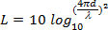
terrestrial microwave
The biggest losses in microwave communication arise from the resistance in the transmission medium.
Loss amount in decibels for microwave and radio waves is expressed as follows.
Here, d refers to the distance between two points and its unit is meters.
λ refers to the wavelength of the signal used and its unit is meter.
As the wavelength of the signal decreases and the distance increases, the loss increases.
43

Slide 58
Karasal mikrodalga
Attenuation in the atmosphere: heavy rain, hail, fog, humidity
It affects different frequencies at different rates with its amount.
The most common bands used for communication over long distances are between 4 GHz and 6 GHz.
Due to the congestion in these frequencies, the 11 GHz band has also started to be used.
12 GHz is already used for cable TV.
The 22 GHz band has started to be used in short-distance communications between buildings.
Higher frequencies are not used due to atmospheric resistance.
44

Slide 59
satellite microwave
A communications satellite is essentially a microwave communications antenna.
A satellite can communicate with more than one microwave receiver and transmitter (ground stations or earth stations) on the ground.
A satellite receives the signal from one frequency band (uplink), amplifies it and sends it to ground stations in another frequency band (downlink).
A satellite operates using multiple bands. These are called transponders. Satellites have some characteristic features depending on their orbits. These are,,
Transmission time of the signal
Visibility times from any point on earth
The length of the path the signal takes in the atmosphere
46

Slide 60
Uydu mikrodalga
The most suitable frequency bands for satellite communications are between 1 GHz and 10 GHz.
For frequencies below 1 GHz, due to atmospheric conditions The effect of noise is very high.
Above 10 GHz frequency, losses begin to increase significantly due to atmospheric resistance.
A significant part of today's satellites use the band between 5.925 GHz and 6.425 GHz for uplink and 3.7 GHz to 4.2 GHz for downlink.
Communication with these satellites is expressed as 4/6 GHz.
47

Slide 61
Uydu mikrodalga
Since the channels on the 4/6 GHz band are no longer sufficient, the 12/14 GHz band has started to be used.
Here, the band between 14 GHz and 14.5 GHz is used for uplink and the band between 11.7 GHz and 12.2 GHz is used for downlink.
It is planned to use the 20/30 GHz band in case this band is insufficient in the coming years.
This band uses 27.5 GHZ to 30 GHz for uplink and 17.7 GHz to 20.2 GHz for downlink.
48

Slide 62
broadcast radio
The most important difference between microwave and broadcast radio is that microwave is directional and broadcast radio is omnidirectional.
In broadcast radio communication, the antennas do not need to be parabolic dishes, and seeing each other does not affect the quality of communication as significantly as in microwave.
Radio waves cover the band between 3 kHz and 300 GHz.
Broadcast radio refers to only the part of this band between 30 MHz and 1 GHz.
This range includes FM radio channels and VHF (Very High Frequency) and UHF (Ultra High Frequency) bands.
The ionosphere layer in the atmosphere acts as a reflector for signals below 30 MHz, while it is permeable for signals above 30 MHz.
50

Slide 63
Broadcast radyo
The following equation given in microwave communication is valid for the amount of loss in the atmosphere.
As the distance between the points where the signal is transmitted increases, the amount of loss increases.
Additionally, as the wavelength of the signal decreases (as its frequency increases), the loss in the signal due to the atmosphere increases.
One of the most important effects in broadcast radio communications is multipath interference.The signal changes its path by hitting different obstacles, and signals belonging to a piece of data reach the receiver by following different paths.
As a result, signals with different amplitudes and arrival times are transmitted to the receiver. When combined, a signal different from the original signal is obtained.
51

Slide 64
Infrared
It is used by modulating infrared light for infrared communication.
The receiver and transmitter must be in the same environment and close to each other.
The most important difference between infrared and microwave is that infrared signals cannot pass through solid objects such as walls.
Microwave signals can pass through such obstacles.
Infrared signals have an advantage in terms of security because they cannot escape from closed environments.
Another important advantage is that the infrared band is license-free and available for use by everyone.
53

Slide 65
Time-Domain Concepts
Electronic devices interact with each other and the real world through the transfer of information. Information transfer is done using signals in analog and digital form.
Analog signal - signal intensity varies in a smooth fashion over time Analog sinyal - sinyal yoğunluğu zamanla düzgün bir şekilde değişir
No breaks or discontinuities in the signal
Digital signal - signal intensity maintains a constant level for some period of time and then changes to another constant level Dijital sinyal - sinyal yoğunluğu bir süre sabit bir seviyede kalır ve daha sonra başka bir sabit seviyeye geçer
Notes:
signal can be either analog or digital.

Slide 66
Time-Domain Concepts
analog signal: is a continuous time, continuous voltage or amplitude signal. is the width signal. Most analog signals can be decomposed into sine waves. The signal can go from positive amplitude to negative amplitude. Analog signal is more susceptible to noise, which creates distortion in the waveform and therefore results in loss of information.
Dijital sinyal, It is a type of signal whose amplitude is not continuous but expresses fixed values ​​separately. The most common type of digital signal is the binary form, where the amplitude can be 0 (low voltage) or 1 (high voltage). More immune to noise since digital signals have only two amplitude values.
Notes:
signal can be either analog or digital.

Slide 67
2.1 Analog and Digital Waveforms

Slide 68
Time-Domain Concepts
Analog Circuit : Electronic circuits that process any analog signal and provide an analog output are called analog circuits. Analog circuits are made from various analog circuit components such as resistors, capacitors, inductors.
Digital Circuit : Electronic circuits that process signals with discrete amplitude, also known as digital signals, are called digital circuits. The digital circuit is created from digital logic gates, which are its basic building blocks.
Since digital circuit works only on digital signal, ADC (Analog to Digital Converter) is used to process real world signals. If the digital output signal needs to interact with real-world components, a DAC (Digital to Analog Converter) must be used in the circuit output.
Notes:
signal can be either analog or digital.

Slide 69
Time-Domain Concepts
A wave that has made a full revolution is one period. The wave that completes its cycle is called period.
Periodic signal - analog or digital signal pattern that repeats over time (zamanla tekrar eden analog veya dijital sinyal modeli)
s(t +T) = s(t) -∞ < t < +∞
where T is the period of the signal
Aperiodic signal - analog or digital signal pattern that doesn't repeat over time Periyodik olmayan sinyal - zamanla tekrarlanmayan analog veya dijital sinyal modeli

Slide 70
2.2 Examples of Periodic Signals
TRANSMISSION FUNDAMENTALS 2-70
Notes:
Figure 2.2 shows an example of a periodic analog signal (sine wave) and a periodic digital signal (square wave).

Slide 71
Time-Domain Concepts
Peak amplitude (A) - maximum value or strength of the signal over time; typically measured in volts
Frequency (f)
Rate, in cycles per second, or Hertz (Hz) at which the signal repeats
Frekans bir olayın birim zaman (genel olarak 1 saniye) içinde hangi sıklıkla, kaç defa tekrarlandığının ölçümüdür. Frekansını ölçmek için bir olayın belirli bir zaman aralığında kaç kere tekrar ettiği sayılır, sonra bu sayı zaman aralığına bölünerek frekans elde edilir.F = 1 / T’dir.
F = Frekans’tır
T = Periyot’tur.
Period (T) -Bir tam dalganın oluşması için geçen süreye periyot denir. “T” harfi ile gösterilir. Frekans ile ters orantılıdır. Birimi saniyedir.
T = 1/f
Phase (ϕ) - measure of the relative position in time within a single period of a signal ( Faz (phase), zaman t=0 iken sinyalin pozisyonunu gösterir
Notes:
A general sine wave can be represented by three parameters:
peak amplitude (A), frequency (f ), and phase (f).
Wavelength (λ) - distance occupied by a single cycle of the signal
Or, the distance between two points of corresponding phase of two consecutive cycles

Slide 72
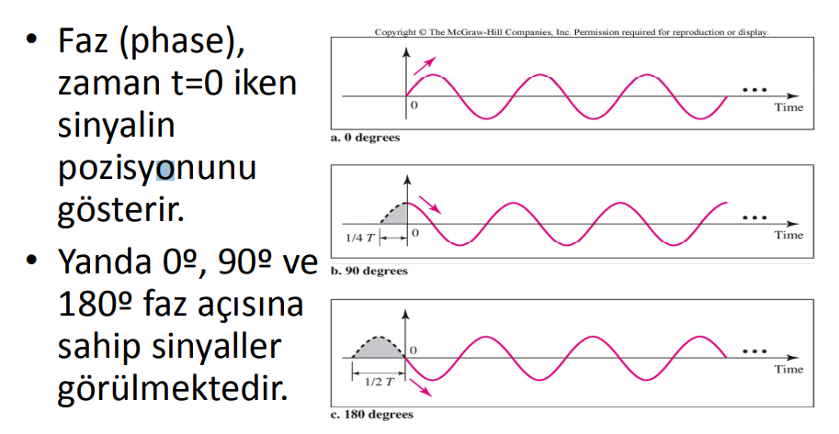
Time-Domain Concepts
Peak amplitude (A) - maximum value or strength of the signal over time; typically measured in volts
Frequency (f)
Rate, in cycles per second, or Hertz (Hz) at which the signal repeats
Frekans bir olayın birim zaman (genel olarak 1 saniye) içinde hangi sıklıkla, kaç defa tekrarlandığının ölçümüdür. Frekansını ölçmek için bir olayın belirli bir zaman aralığında kaç kere tekrar ettiği sayılır, sonra bu sayı zaman aralığına bölünerek frekans elde edilir.F = 1 / T’dir.
F = Frekans’tır
T = Periyot’tur.
Period (T) -Bir tam dalganın oluşması için geçen süreye periyot denir. “T” harfi ile gösterilir. Frekans ile ters orantılıdır. Birimi saniyedir.
T = 1/f
Phase (ϕ) - measure of the relative position in time within a single period of a signal ( Faz (phase), zaman t=0 iken sinyalin pozisyonunu gösterir
Notes:
A general sine wave can be represented by three parameters:
peak amplitude (A), frequency (f ), and phase (f).
Wavelength (λ) - distance occupied by a single cycle of the signal
Or, the distance between two points of corresponding phase of two consecutive cycles

Slide 73
Time-Domain Concepts
Some information about frequency from daily life
>What is the speed of the processor?
>1.7Ghz. 3.Ghz with turbo.
>What is the frequency of April 3rd Radio?
>105.50Mhz
The term frequency used in radios, walkie-talkies, computers,... basically means: the same number of events repeated in 1 second. For example, when it comes to frequency in radio, what needs to be understood is the number of times the waves of the signal sent by the radio transmitter repeat themselves in 1 second. Or the term frequency used in the computer means "how many times" the processor processes data in 1 second.
Notes:
A general sine wave can be represented by three parameters:
peak amplitude (A), frequency (f ), and phase (f).
Wavelength (λ) - distance occupied by a single cycle of the signal
Or, the distance between two points of corresponding phase of two consecutive cycles

Slide 74
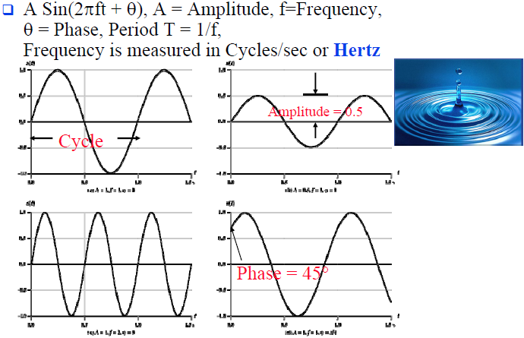
Frequency, Period, and Phase
Function of time

Slide 75
Sine Wave Parameters
General sine wave
s(t ) = A sin(2πft + ϕ)
Figure 2.3 shows the effect of varying each of the three parameters
(a) A = 1, f = 1 Hz, ϕ = 0; thus T = 1 s
(b) Reduced peak amplitude; A=0.5
(c) Increased frequency; f = 2, thus T = ½
(d) Phase shift; ϕ = π/4 radians (45 degrees)
Note: 2π radians = 360° = 1 period

Slide 76
2.3 s(t) = A sin (2πft + ϕ)
Notes:
Figure 2.3 shows the effect of varying each of the three parameters
(a) A = 1, f = 1 Hz, ϕ = 0; thus T = 1 s
(b) Reduced peak amplitude; A=0.5
(c) Increased frequency; f = 2, thus T = ½
(d) Phase shift; ϕ = π/4 radians (45 degrees)
Note: 2π radians = 360° = 1 period
part (d) shows the effect of a phase shift of p/ 4 radians

Slide 77
2.3 s(t) = A sin (2πft + ϕ)
Notes:
Figure 2.3 shows the effect of varying each of the three parameters
(a) A = 1, f = 1 Hz, ϕ = 0; thus T = 1 s
(b) Reduced peak amplitude; A=0.5
(c) Increased frequency; f = 2, thus T = ½
(d) Phase shift; ϕ = π/4 radians (45 degrees)
Note: 2π radians = 360° = 1 period
part (d) shows the effect of a phase shift of p/ 4 radians

Slide 78
Time vs. Distance
When the horizontal axis is time, as in Figure 2.3, graphs display the value of a signal at a given point in space as a function of time
With the horizontal axis in space, graphs display the value of a signal at a given point in time as a function of distance
At a particular instant of time, the intensity of the signal varies as a function of distance from the source

Slide 79
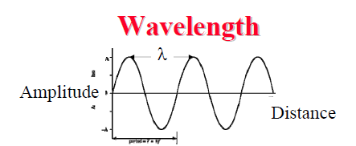
Time-Domain Concepts
Wavelength (λ) - distance occupied by a single cycle of the signal
Or, the distance between two points of corresponding phase of two consecutive cycles
Dalga boyu, bir dalga grubunun tekrarlanan birimleri arasındaki mesafedir. Sembol olarak lamda (λ) harfi ile gösterilmektedir. Dalga boyu frekans ile ters orantılı bir ilişki vardır. Dalga boyu uzadıkça frekans azalır. Çoğu durumda, dalganın boşlukta ilerlediğinin kabulü ile dalga hızı (v) ışık hızı (c) olarak seçilir. Bu durumda formül aşağıdaki gibi olur:
Wavelength = λ
Assuming signal velocity v
λ = vT
λ f = v
v = c = 3×10 ^8 m/s (speed of light in free space) = 300 m/us

Slide 80
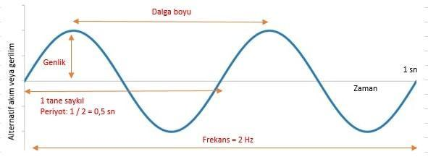
Frequency, Period, and Phase

Slide 81
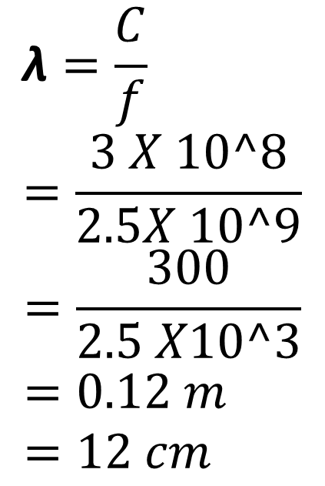
Example
$$\text{λ}=\frac{C}{f} \\ =\frac{3 X 10^8}{2.5X 10^9}$$
$$=\frac{300}{2.5 X10^3} \\ =0.12 m \\ =12 cm$$
Given the frequency
F = 2.5 GHZ
What is λ?

Slide 82
Frequency-Domain Concepts
Any electromagnetic signal can be shown to consist of a collection of periodic analog signals (sine waves) at different amplitudes, frequencies, and phases- elektromanyetik bir sinyal, farklı genlik, frekans ve fazlarda periyodik analog sinyaller (sinüs dalgaları) birleşiminden oluşmaktadır.
The period of the total signal is equal to the period of the fundamental frequency – Tüm sinyalin periyodu, temel frekansın periyoduna eşittir.

Slide 83
Frequency-Domain Concepts
Fundamental frequency - when all frequency components of a signal are integer multiples of one frequency, it’s referred to as the fundamental frequency -Bir sinyalin tüm frekans bileşenleri bir frekansın tam sayı katları olduğunda, temel frekans olarak adlandırılır.
Spectrum - range of frequencies that a signal contains-bir sinyalin içerdiği frekans aralığı
For the signal of Figure 2.4c, the spectrum extends from f to 3f.
Absolute bandwidth - width of the spectrum of a signal
In the case of Figure 2.4c, the bandwidth is 3f - f = 2f
Effective bandwidth (or just bandwidth) - narrow band of frequencies that most of the signal’s energy is contained in

Slide 84
2.4 Addition of frequency Components(T = 1/f)

Slide 85
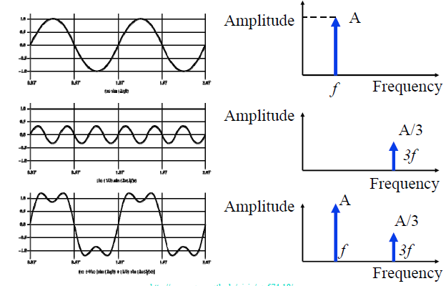
Time and Frequency Domains

Slide 86
2.5 Frequency Components of Square Wave

Slide 87
Relationship between Data Rate and Bandwidth
Data rate = The amount of data transferred or transmitted.
The greater the bandwidth, the higher the information-carrying capacity-Bant genişliği ne kadar büyük olursa, bilgi taşıma kapasitesi o kadar yüksek olur
Suppose that we let a positive pulse represent binary 0
and a negative pulse represent binary 1.
The duration of each pulse is 1/(2f );
thus the data rate is 2f bits per second (bps).
What are the frequency components of this signal?

Slide 88
2.5 Frequency Components of Square Wave

Slide 89
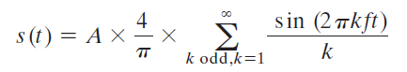
2.5 Frequency Components of Square Wave

Slide 90
Relationship between Data Rate and Bandwidth
This waveform has an infinite number of frequency components and hence an infinite bandwidth.
However, the peak amplitude of the kth frequency component, kf, is only 1/k
so most of the energy in this waveform is in the first few frequency components.
What happens if we limit the bandwidth to just the first three frequency components?
What data rate can be achieved? -Hangi veri hızına ulaşılabilir?

Slide 91
Relationship between Data Rate and Bandwidth
Case 1:
Assume: f = 10^6 cycles/second = 1 MHz
then the bandwidth of the signal is (5 * 1 0 ^6) - 1 0 ^6 = 4 MHz
the period of the fundamental frequency is T = 1/10^ 6 = 1 0^( -6) = 1 us
one bit occurs every 0 .5 us
data rate of 2 * 10^6 = 2 Mbps
Thus, for a bandwidth of 4 MHz, a data rate of 2 Mbps is achieved.

Slide 92
Relationship between Data Rate and Bandwidth
Case II. suppose that we have a bandwidth of 8 MHz.
f = 2 MHz.
Using the same line of reasoning as before,
the bandwidth of the signal is
(5 * 2 * 10^6) - (2 * 10^6) = 8 MHz.
In this case T = 1/f = 0.5 us .
As a result, one bit occurs every 0.25 us for a data rate of 4 Mbps.

Slide 93
Relationship between Data Rate and Bandwidth
Conclusions
Any digital waveform will have infinite bandwidth-Herhangi bir dijital dalga biçimi sonsuz bant genişliğine sahip olacaktır
BUT the transmission system will limit the bandwidth that can be transmitted-AMA iletim sistemi, iletilebilecek bant genişliğini sınırlayacaktır.
AND, for any given medium, the greater the bandwidth transmitted, the greater the cost-VE, herhangi bir ortam için iletilen bant genişliği ne kadar büyükse, maliyet de o kadar yüksek olur
HOWEVER, limiting the bandwidth creates distortions - bant genişliğini sınırlamak bozulmalar yaratır

Slide 94
Data Communication Terms
Data –
entities that convey meaning, or information -anlam veya bilgi taşıyan varlıklar
Signals –
electric or electromagnetic representations of data-verilerin elektriksel veya elektromanyetik gösterimleri
Transmission –
communication of data by the propagation and processing of signals -sinyallerin yayılması ve işlenmesi yoluyla veri iletişimi

Slide 95
Examples of Analog and Digital Data
Analog
Video
Audio
Digital
Text
Integers

Slide 96
Analog Signals
A continuously varying electromagnetic wave that may be propagated over a variety of media, depending on frequency -Frekansa bağlı olarak çeşitli ortamlar üzerinde yayılabilen sürekli değişen bir elektromanyetik dalga
Examples of media:
Copper wire media (twisted pair and coaxial cable)
Fiber optic cable
Atmosphere or space propagation (wireless).
Analog signals can propagate analog and digital data Analog sinyaller, analog ve dijital verileri yayabilir
Notes:
In a communications system, data are propagated from one point to another by means of electromagnetic signals.

Slide 97
Digital Signals
A sequence of voltage pulses that may be transmitted over a copper wire medium-Bakır tel ortamı üzerinden iletilebilen bir dizi voltaj darbesi
Generally cheaper than analog signaling-Genellikle analog sinyallemeden daha ucuzdur
Less susceptible to noise interference -Gürültü parazitine karşı daha az duyarlı
Suffer more from attenuation
Digital signals can propagate analog and digital data -Dijital sinyaller, analog ve dijital verileri yayabilir

Slide 98
2.8 Analog Signaling of Analog and Digital Data

Slide 99
2.6 Acoustic Spectrum of Speech and Music

Slide 100
2.8 Digital Signaling of Analog and Digital Data

Slide 101
Reasons for Choosing Data and Signal Combinations
Digital data, digital signal
Equipment for encoding is less expensive than digital-to-analog equipment
Analog data, digital signal
Conversion permits use of modern digital transmission and switching equipment
Digital data, analog signal
Some transmission media will ONLY propagate analog signals
Examples include optical fiber and satellite, and atmosphere or space propagation (wireless).
Analog data, analog signal
Analog data easily converted to analog signal

Slide 102
Analog Transmission
Transmit analog signals without regard to content
Attenuation limits length of transmission link
Cascaded amplifiers boost signal’s energy for longer distances but cause distortion
Analog data can tolerate distortion
Introduces errors in digital data

Slide 103
Digital Transmission
Concerned with the content of the signal
digital signal can be propagated only a limited distance before Attenuation endangers integrity of data
To achieve greater distances
Digital Signal
Repeaters achieve greater distance
Repeaters recover the signal and retransmit
Analog signal carrying digital data
Retransmission device recovers the digital data from analog signal
Generates new, clean analog signal

Slide 104
About Channel Capacity
Impairments, such as noise, limit data rate that can be achieved
For digital data, to what extent do impairments limit data rate that can be achieved?
Channel Capacity – the maximum rate at which data can be transmitted over a given communication path, or channel, under given conditions

Slide 105
Concepts Related to Channel Capacity
Data rate - rate at which data can be communicated (bps)
Bandwidth - the bandwidth of the transmitted signal as constrained by the transmitter and the nature of the transmission medium (Hertz)
Noise - average level of noise over the communications path
Error rate - rate at which errors occur
Error = transmit 1 and receive 0; transmit 0 and receive 1

Slide 106
2.9 Effect of Noise on Digital Signal

Slide 107
Nyquist’s formula
For binary signals (two voltage levels)
C = 2B
With multilevel signaling
C = 2B log₂ M
M = number of discrete signal or voltage levels

Slide 108
Signal-to-Noise Ratio
Ratio of the power in a signal to the power contained in the noise that is present at a particular point in the transmission
Typically measured at a receiver
Signal-to-noise ratio (SNR, or S/N)
A high SNR means a high-quality signal, low number of required intermediate repeaters
SNR sets upper bound on achievable data rate

Slide 109
Shannon Capacity Formula
Equation:
Represents theoretical maximum that can be achieved
In practice, only much lower rates achieved
Formula assumes white noise (thermal noise)
Impulse noise is not accounted for
Attenuation distortion or delay distortion not accounted for

Slide 110
Example of Nyquist and Shannon Formulations
Spectrum of a channel between 3 MHz and 4 MHz ; SNR_{dB} = 24 dB
Using Shannon’s formula

Slide 111
Example of Nyquist and Shannon Formulations
How many signaling levels are required?

Slide 112
Classifications of Transmission Media
Guided Media
Waves are guided along a solid medium
E.g., copper twisted pair, copper coaxial cable, optical fiber
Unguided Media
Provides means of transmission but does not guide electromagnetic signals
Usually referred to as wireless transmission
E.g., atmosphere, outer space

Slide 113
Unguided Media
Transmission and reception are achieved by means of an antenna
Configurations for wireless transmission
Directional
Omnidirectional

Slide 114
2.10 Electromagnetic spectrum of Telecommunications

Slide 115
General Frequency Ranges
Microwave frequency range
1 GHz to 40 GHz
Directional beams possible
Suitable for point-to-point transmission
Used for satellite communications
Radio frequency range
30 MHz to 1 GHz
Suitable for omnidirectional applications
Infrared frequency range
Roughly, 3x10¹¹ to 2x10¹⁴ Hz
Useful in local point-to-point multipoint applications within confined areas

Slide 116
Terrestrial Microwave
Description of common microwave antenna
Parabolic "dish", 3 m in diameter
Fixed rigidly and focuses a narrow beam
Achieves line-of-sight transmission to receiving antenna
Located at substantial heights above ground level
Applications
Long haul telecommunications service
Short point-to-point links between buildings

Slide 117
Satellite Microwave
Description of communication satellite
Microwave relay station
Used to link two or more ground-based microwave transmitter/receivers
Receives transmissions on one frequency band (uplink), amplifies or repeats the signal, and transmits it on another frequency (downlink)
Applications
Television distribution
Long-distance telephone transmission
Private business networks

Slide 118
Broadcast Radio
Description of broadcast radio antennas
Omnidirectional
Antennas not required to be dish-shaped
Antennas need not be rigidly mounted to a precise alignment
Applications
Broadcast radio
VHF and part of the UHF band; 30 MHZ to 1GHz
Covers FM radio and UHF and VHF television

Slide 119
Summary
Signals for Conveying Information
Time Domain Concepts
Frequency Domain Concepts
Relationship between Data Rate and Bandwidth
Analog and Digital Data Transmission
Analog and Digital Data
Analog and Digital Signaling
Analog and Digital Transmission
Channel Capacity
Nyquist Bandwidth
Shannon Capacity Formula
Transmission Media
Terrestrial Microwave
Satellite Microwave
Broadcast Radio

Slide 120
Thank You Q & A
Adib Habbal, Ph.D., Department of Computer Engineering Faculty of Engineering, Karabuk University
Email: adibhabbal@karabuk.edu.tr

